Slide 1


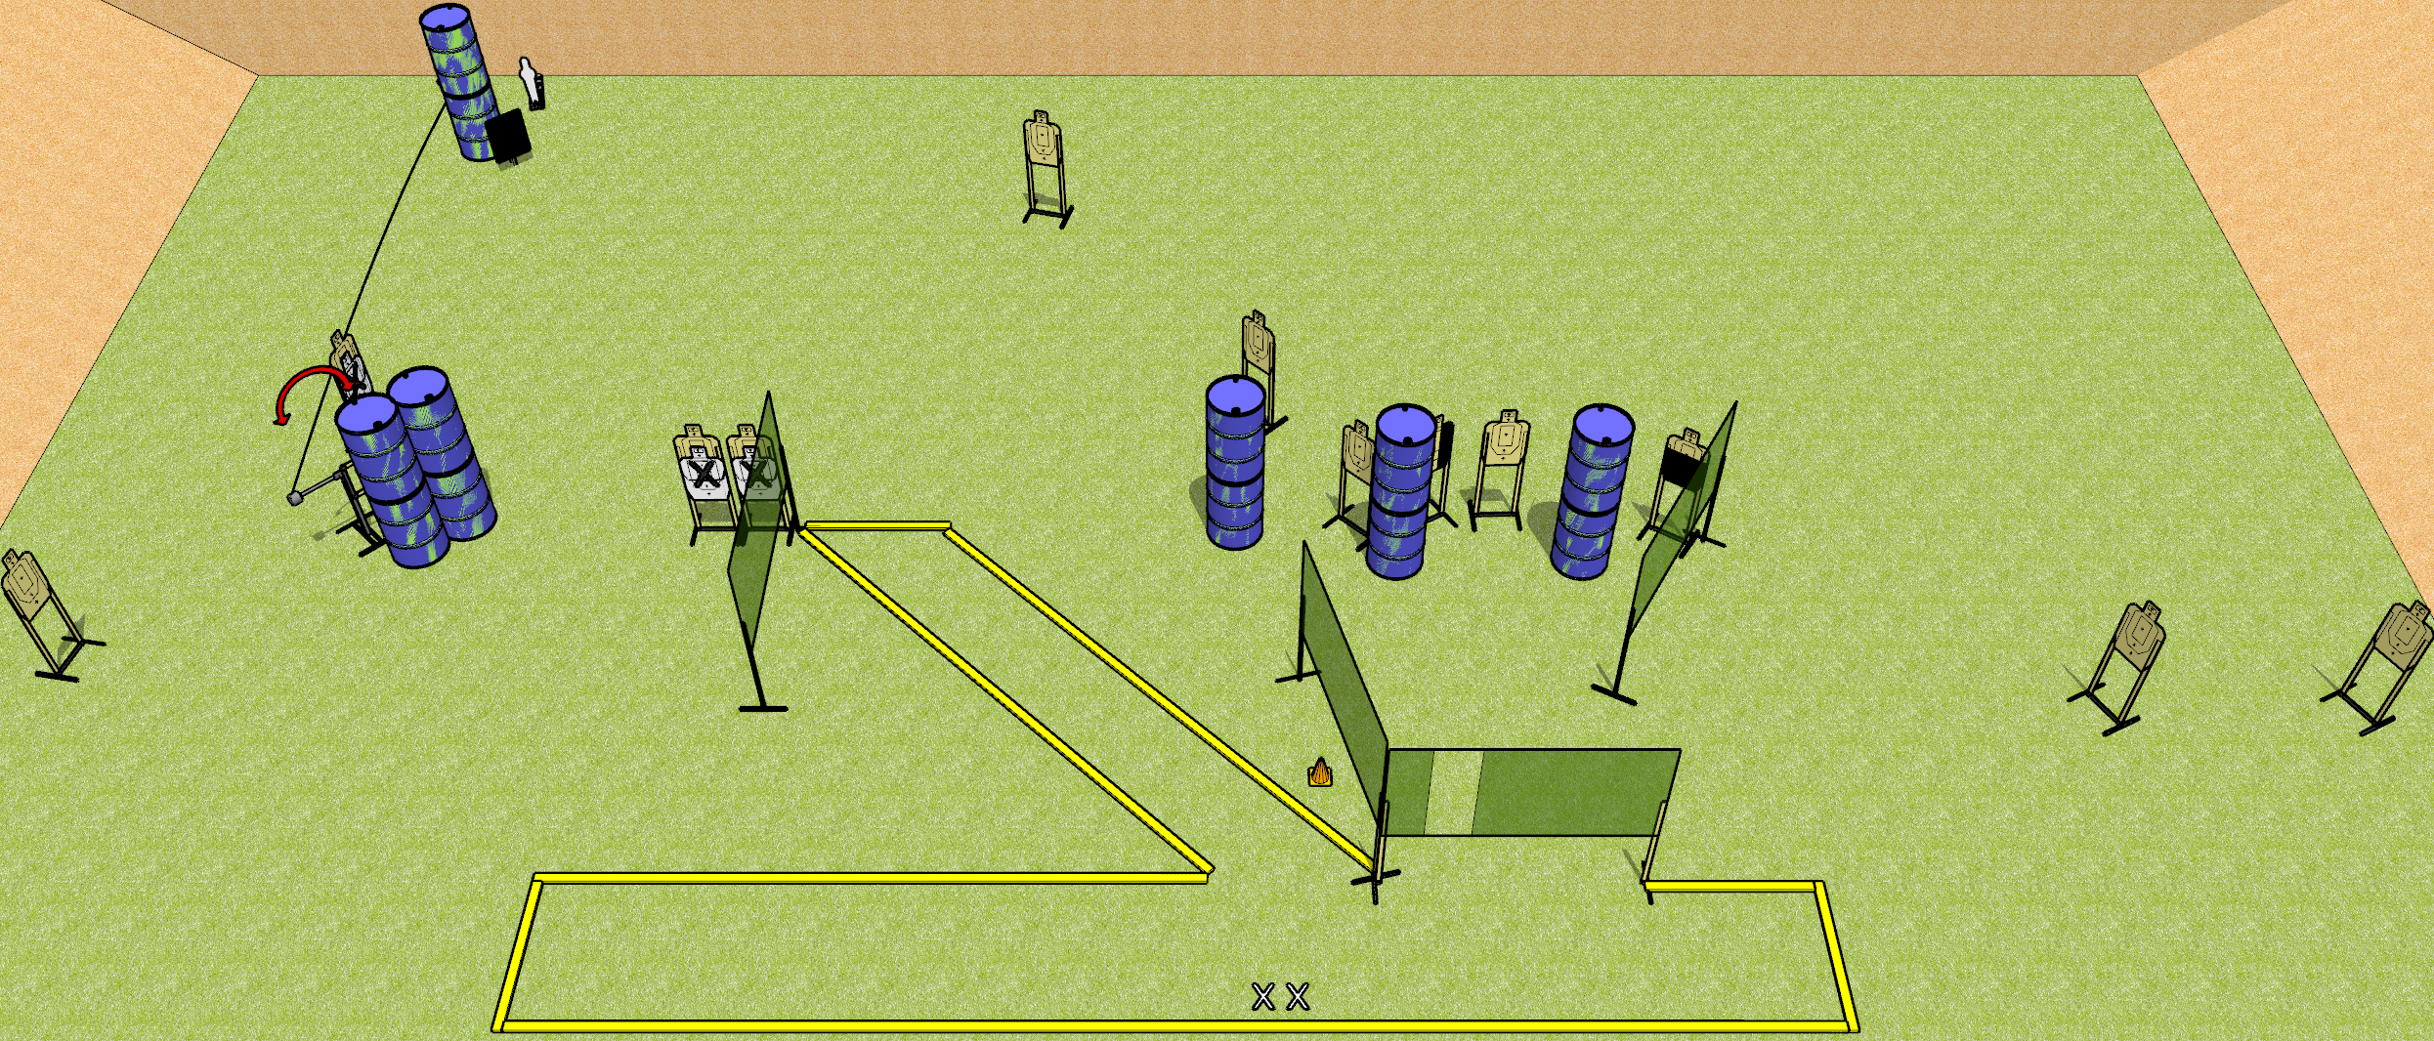
 | Dothan Gun Club – USPSA Match Spiky Course Designer : Drew Coleman
START POSITION : Both feet on X’s, wrists below belt
GUN READY CONDITION : Pistol loaded and holstered. PCC loaded, held with both hands, shouldered, safety on, pointed at orange cone. |  | SCORING: Comstock, 28 rounds TARGETS: 13 paper, 2 Steel SCORED HITS: Best 2 on paper, steel until down START-STOP: Audible, last shot RULES: Swinger must be activated before being engaged
STAGE PROCEDURE: Engage targets as they become available from within the fault lines.

Slide 2
Spiky
Written Stage Briefing
Spiky is a 28 round, 140 point, Comstock field course. There are thirteen USPSA targets and two mini poppers. The best two hits on paper will score, and steel must fall to score. The start signal is audible.
The left mini popper will activate the swinger. Please check the activator prior to walkthrough and set it up the same way every time. The swinger must be activated before being engaged.
Handgun start position is both feet on X’s, wrists below belt. Handgun is loaded and holstered.
PCC start position is both feet on X’s, muzzle pointed at orange cone. Loaded carbine is held with both hands, safety on, shouldered.
On start signal, engage targets as they become available from within the shooting area.

